Slide 1
JDBC

Slide 2
Introduction
Java application cannot directly communicate with database
This is because a database can interpret only SQL statements and not java language statements for this reason, we need a mechanism to translate java statements into SQL statements
JDBC API provides the mechanism for the kind of translation
JDBC stands for Java Database Connectivity
It is a standard Java API for database-independent connectivity between the Java programming language and a wide range of databases

Slide 3
Why JDBC API
Two issues :
Java applications cannot directly communicate with a database.
Java application should be database independent.
JDBC API uses driver to address the above issues.
How?
JDBC API takes care of converting java Commands to generic SQL statements.
JDBC API uses drivers provided by Database vendors to communicate with database.
Java Application invokes methods JDBC API.

Slide 4
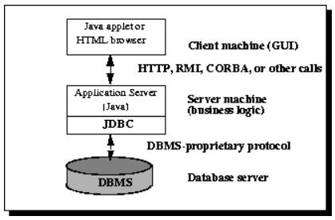
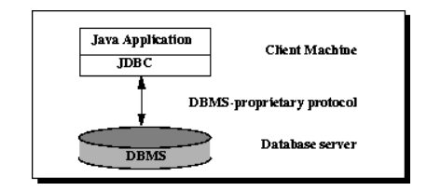
JDBC

Slide 5
Categories of JDBC drivers
There are several categories of JDBC drivers provided by different database vendors:
1) JDBC-ODBC driver:-
Database server contain the ODBC driver embedded into them.
ODBC APIs are written in C language and makes the use of pointers and other constructs that JAVA doesnot support.
Hence JDBC-ODBC bridge driver are used to translate the JDBC API to the ODBC API.
2) Native API partly Java Driver:
Supplied by vendors of database like DB2,Informix provides JDBC drivers in terms of classes that are directly invoked by JDBC API.
3) Native protocol pure java driver/JDBC-Net pure java driver:
These drivers are used to connect a client application or applet to a database over a TCP/IP connection.

Slide 6
JDBC Driver Manager
It is a backbone of the JDBC architecture.
The function of JDBC driver manager are to maintain a list of drivers created for different databases and
Connect a Java application to appropriate driver specified in a Java program.
JDBC-ODBC bridge:
It is implemented as the JdbcOdbc.class and a native library is used to access the ODBC driver.
In a Windows platform ,native library is JDBCODBC.dll.
ACCESS DRIVER
MS-ACCESS
Application
JDBC Driver Manager
JDBC-ODBC BRIDGE
DRIVER
SQL DRIVER
MS-SQL
JDBC Application Architecture Using the JDBC-ODBC Bridge Driver

Slide 7
Steps to connect to the database
There are 5 steps to connect any java application with the database using JDBC.
These steps are as follows:
1. Register the Driver class
2. Create connection
3. Create statement
4. Execute queries
5. Close connection

Slide 8
1. Register the driver class
forName method of Class class is used to register the driver class
This method is used to dynamically load the driver class
Syntax of forName method:
public static void forName (String className )throws ClassNotFoundException
Calling a method:
Class.forName(“com.mysql.cj.jdbc.Driver”);

Slide 9
2. Create the connection object
getConnection method of DriverManager class is used to establish connection with the database.
Syntax of getConnection() method: (two forms)
public static Connection getConnection(String url)throws SQLException
public static Connection getConnection(String url,String name,String password)throws SQLException
Calling a method:
Connection con= DriverManager.getConnection(“jdbc:mysql://localhost:3306/Student”,”root”,”root”);

Slide 10
3. Create the Statement object
createStatement() method of Connection interface is used to create statement.
object of statement is responsible to execute queries with the database.
Syntax of createStatement() method:
public Statement createStatement()throws SQLException
Calling a method:
Statement stmt=con.createStatement();

Slide 11
4. Execute the query
executeQuery() method of Statement interface is used to execute queries to the database.
This method returns the object of ResultSet that can be used to get all the records of a table
Syntax of executeQuery() method
public ResultSet executeQuery (String sql )throws SQLException
Calling a method:
ResultSet rs= stmt.executeQuery (“select * from stud”);

Slide 12
4. Execute the query Contd..
ResultSet object provides you with methods to access data from a table.
1) It maintains a cursor pointing to its current row of data
2)Initially the cursor is positioned before the first row.
3) The next() moves the cursor to the next row.
4) We can retrieve data from ResultSet rows by calling getXXX(int cn)
5) XXX refers to a database of a column such as String ,Integer and Float and cn specifies Column number in the ResultSet.

Slide 13

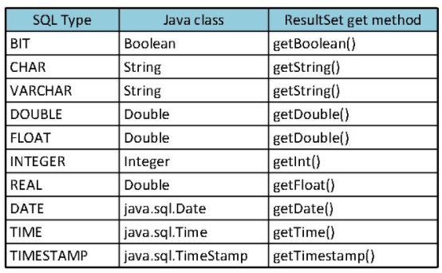

Slide 14
How to execute parametrized query
PreparedStatement object allows you to execute the parametrized queries.
Let's see the example of parameterized query:
String sql="insert into emp values(?,?,?)";
Why use PreparedStatement?
As you can see, we are passing parameter (?) for the values. Its value will be set by calling the setter methods of PreparedStatement.
Improves performance: The performance of the application will be faster if you use PreparedStatement interface because query is compiled only once.

Slide 15
How to execute parametrized query
Ex:
PreparedStatement stmt=con.prepareStatement("insert into Emp values(?,?)");
stmt.setInt(1,101);//1 specifies the first parameter in the query
stmt.setString(2,"Ratan");
int i=stmt.executeUpdate();
System.out.println(i+" records inserted");

Slide 16
5. Close the connection object
By closing connection object, Statement and ResultSet will be closed automatically
The close() method of Connection interface is used to close the connection
Syntax of close() method:
public void close() throws SQLException
Calling a method:
con.close();

Slide 17

JDBC program to insert record in a stud table of database Student

Slide 18
Import java.sql.*;
public class JDBCDEMO
{ // JDBC driver name and database URL
static final String JDBC_DRIVER = "com.mysql.cj.jdbc.Driver";
static final String DB_URL = "jdbc:mysql://localhost:3306/Student";
// Database credentials
static final String USER = "root";
static final String PASS = "root";
public static void main(String[] args) {
Connection conn = null;
Statement stmt = null;
try{
//Register JDBC driver
Class.forName(JDBC_DRIVER );
//Open a connection
System.out.println("Connecting to database...");
conn =DriverManager.getConnection(DB_URL,USER,PASS);
//Execute a query
System.out.println("Creating statement...");
stmt = conn.createStatement();
String sql;
sql = "insert into stud(name,rollno) values ('xyz','3')";
int r= stmt.executeUpdate(sql);
ResultSet rs = stmt.executeQuery("Select * from stud");
//Extract data from result set
while(rs.next()){
System.out.println("Roll no: "+rs.getInt(2)+" Name: "+rs.getString(1)); }
//Clean-up environment
rs.close(); stmt.close(); conn.close();
}catch(SQLException se){
se.printStackTrace(); }
catch(Exception e){
e.printStackTrace(); }
System.out.println("Goodbye!");
}

Slide 19
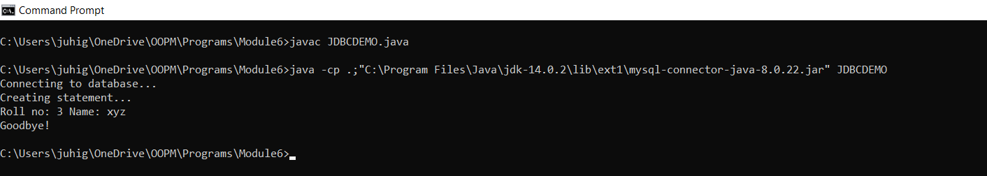
Output

